Slide 1
Pre-lab Questions

Slide 2
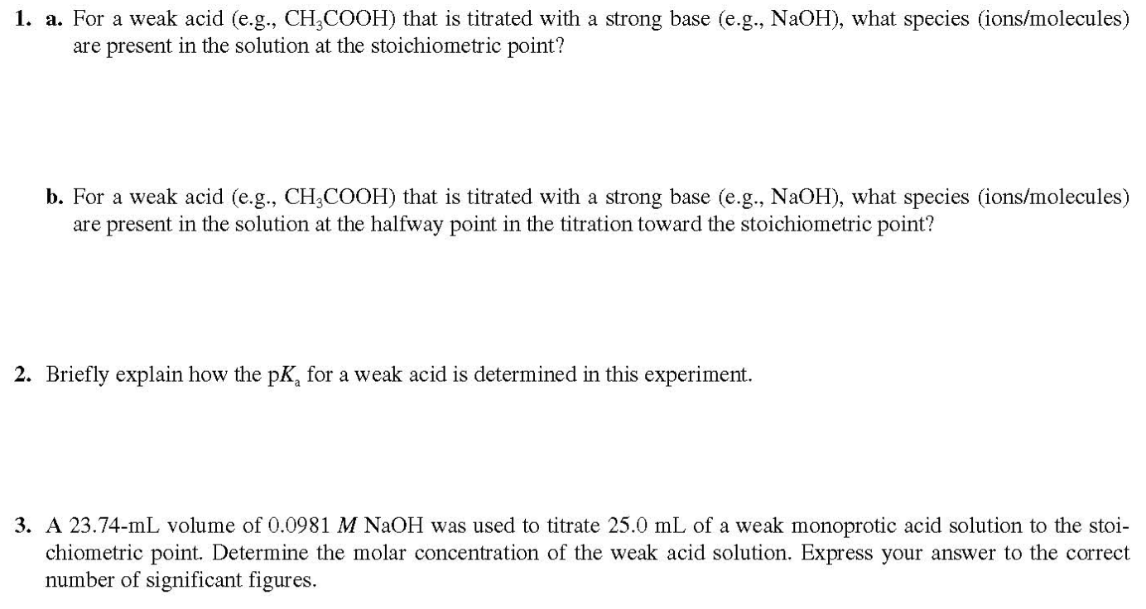
(4 points)
(4 points)
(5 points)

Slide 3
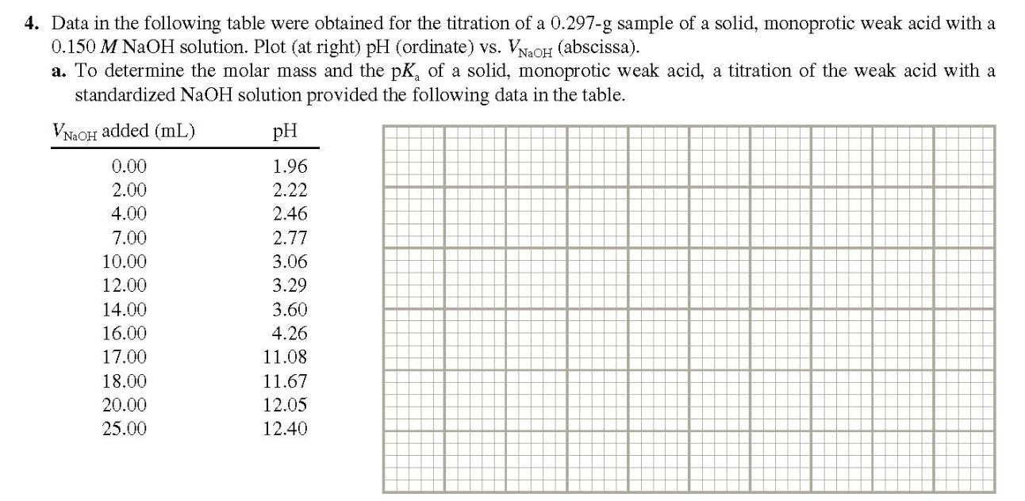
(Problem 4-a will not be graded.)

Slide 4
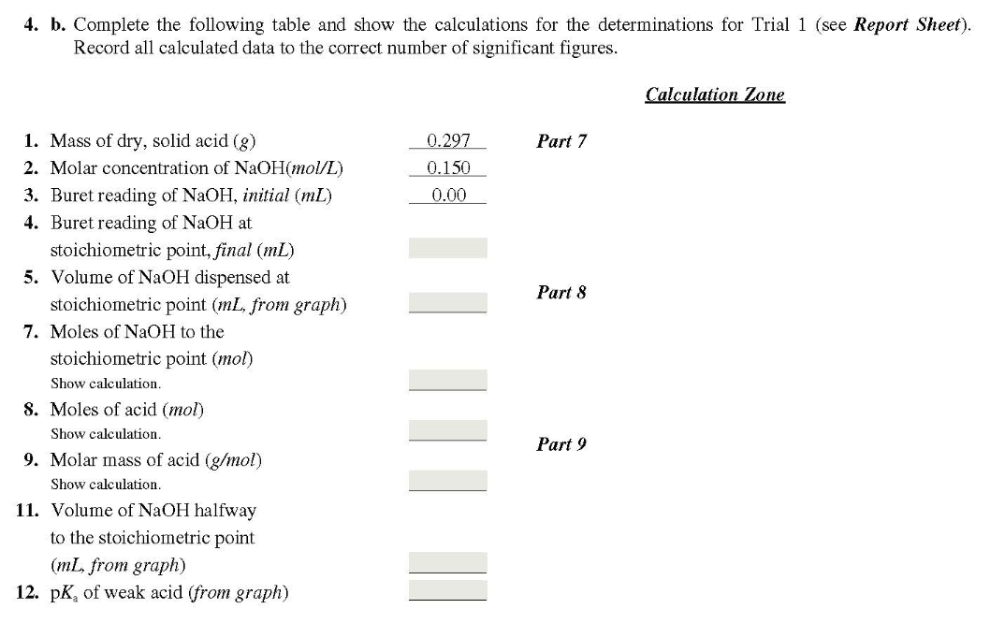
(7 points)

Slide 5
Laboratory Reports
Use the format shown in manual(page 32~34).
+ Discussion(Summary/Assessing the result/Conclusion) should be included here.

Slide 6
Post-lab Questions
(#1, 2, 4, 5, 6; 4 points each)

Slide 7
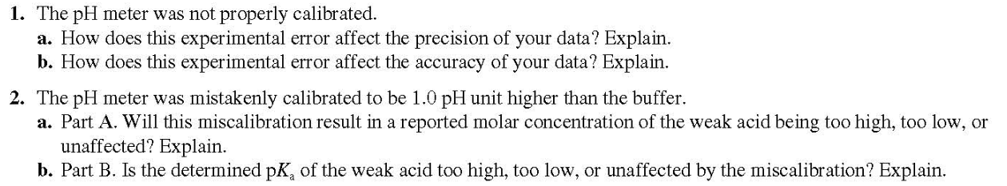
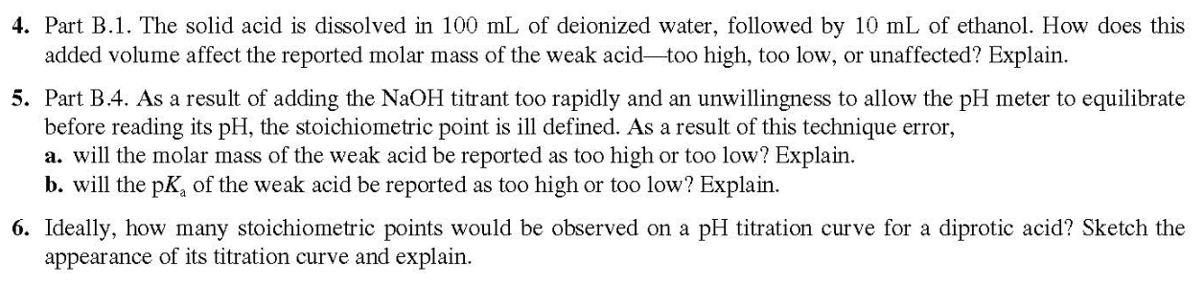

Slide 8
Textbook Content for Exp.8

Slide 9
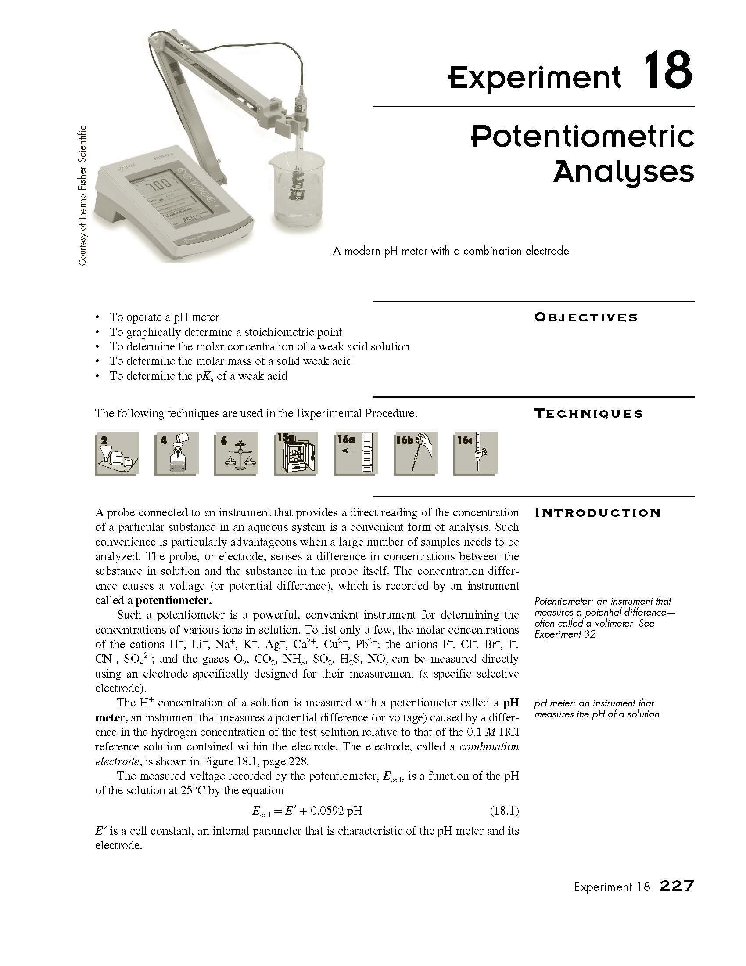
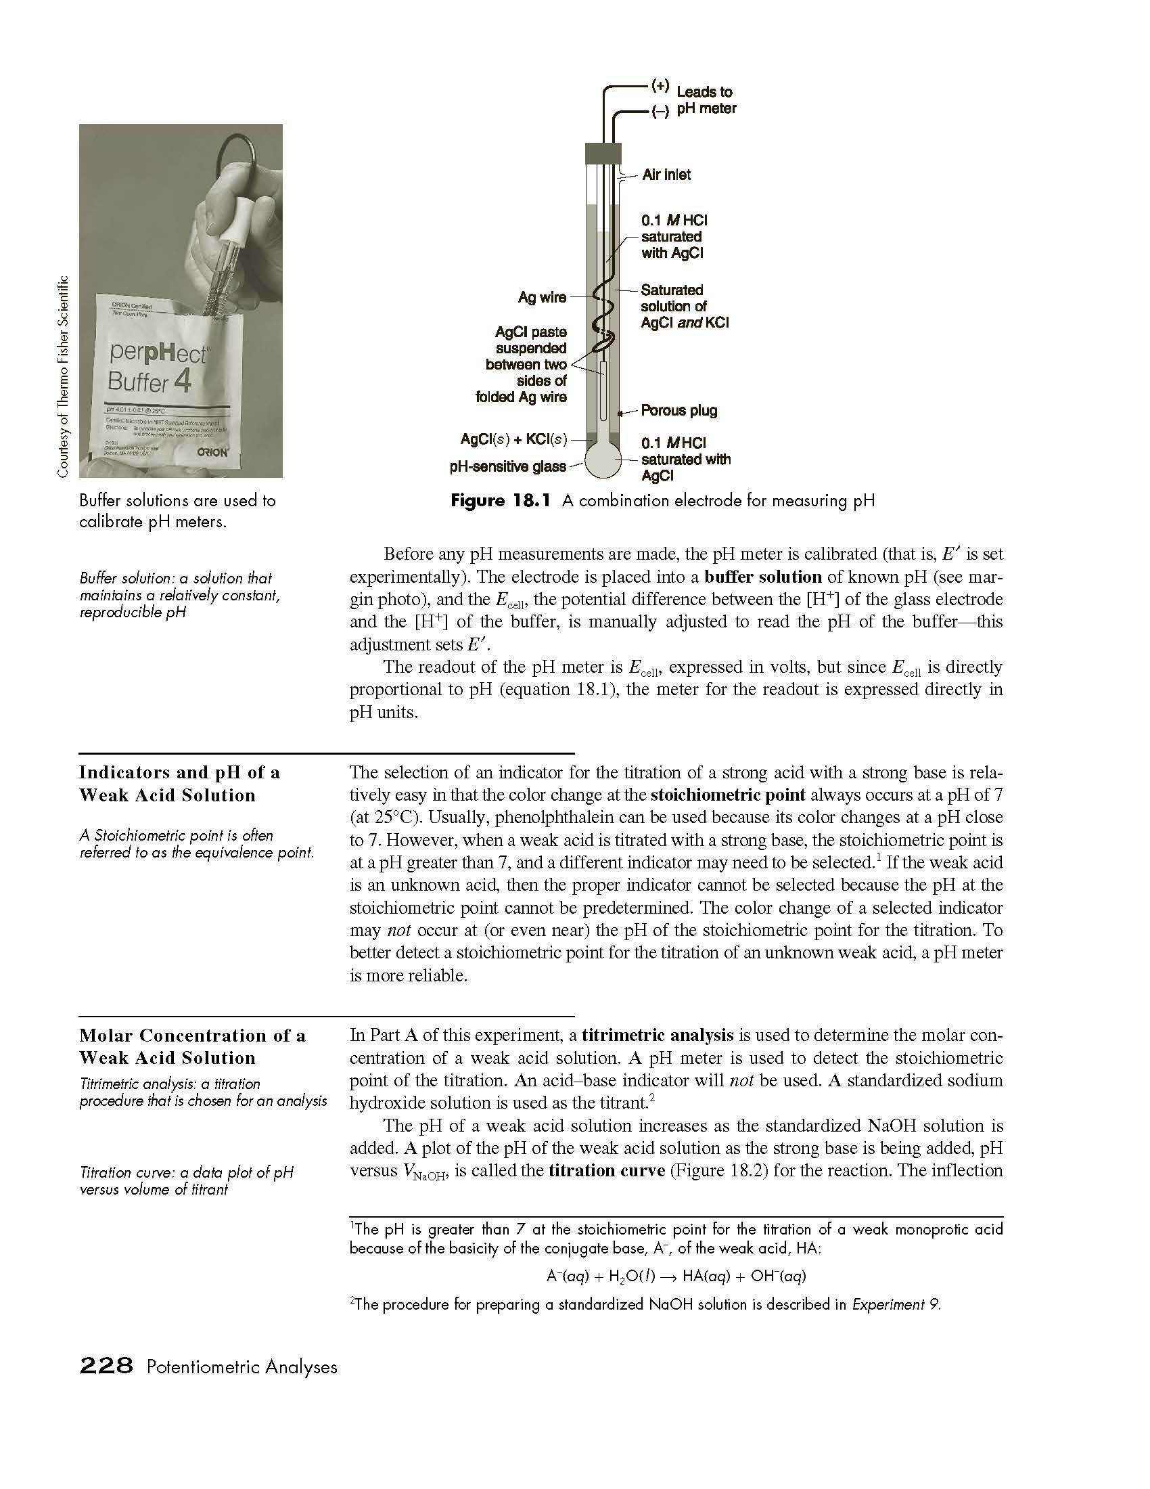

Slide 10
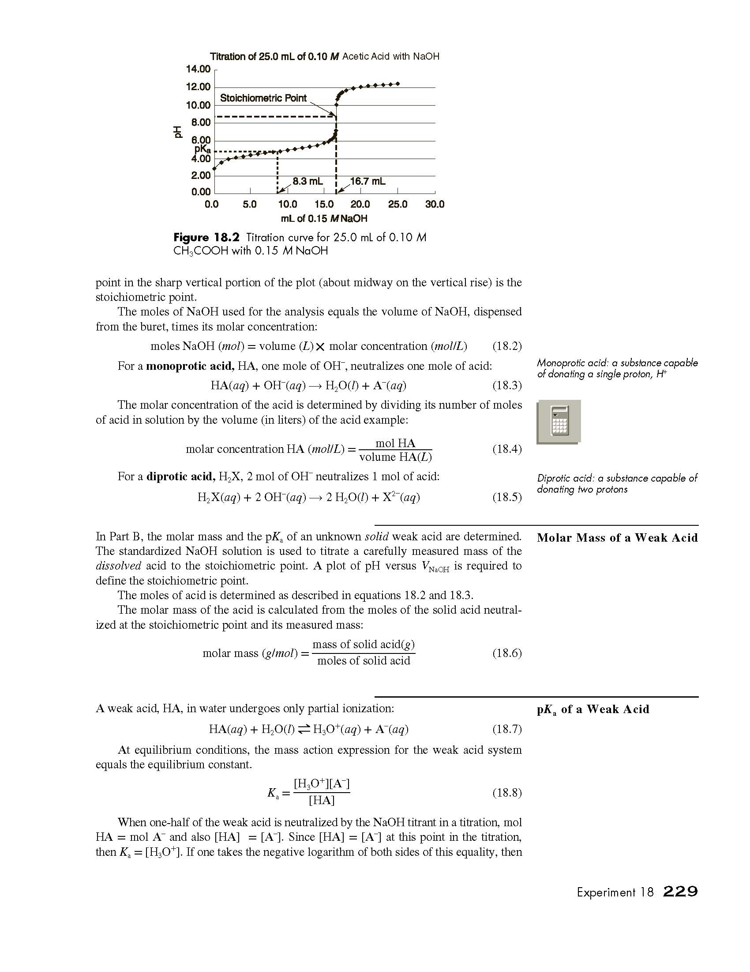
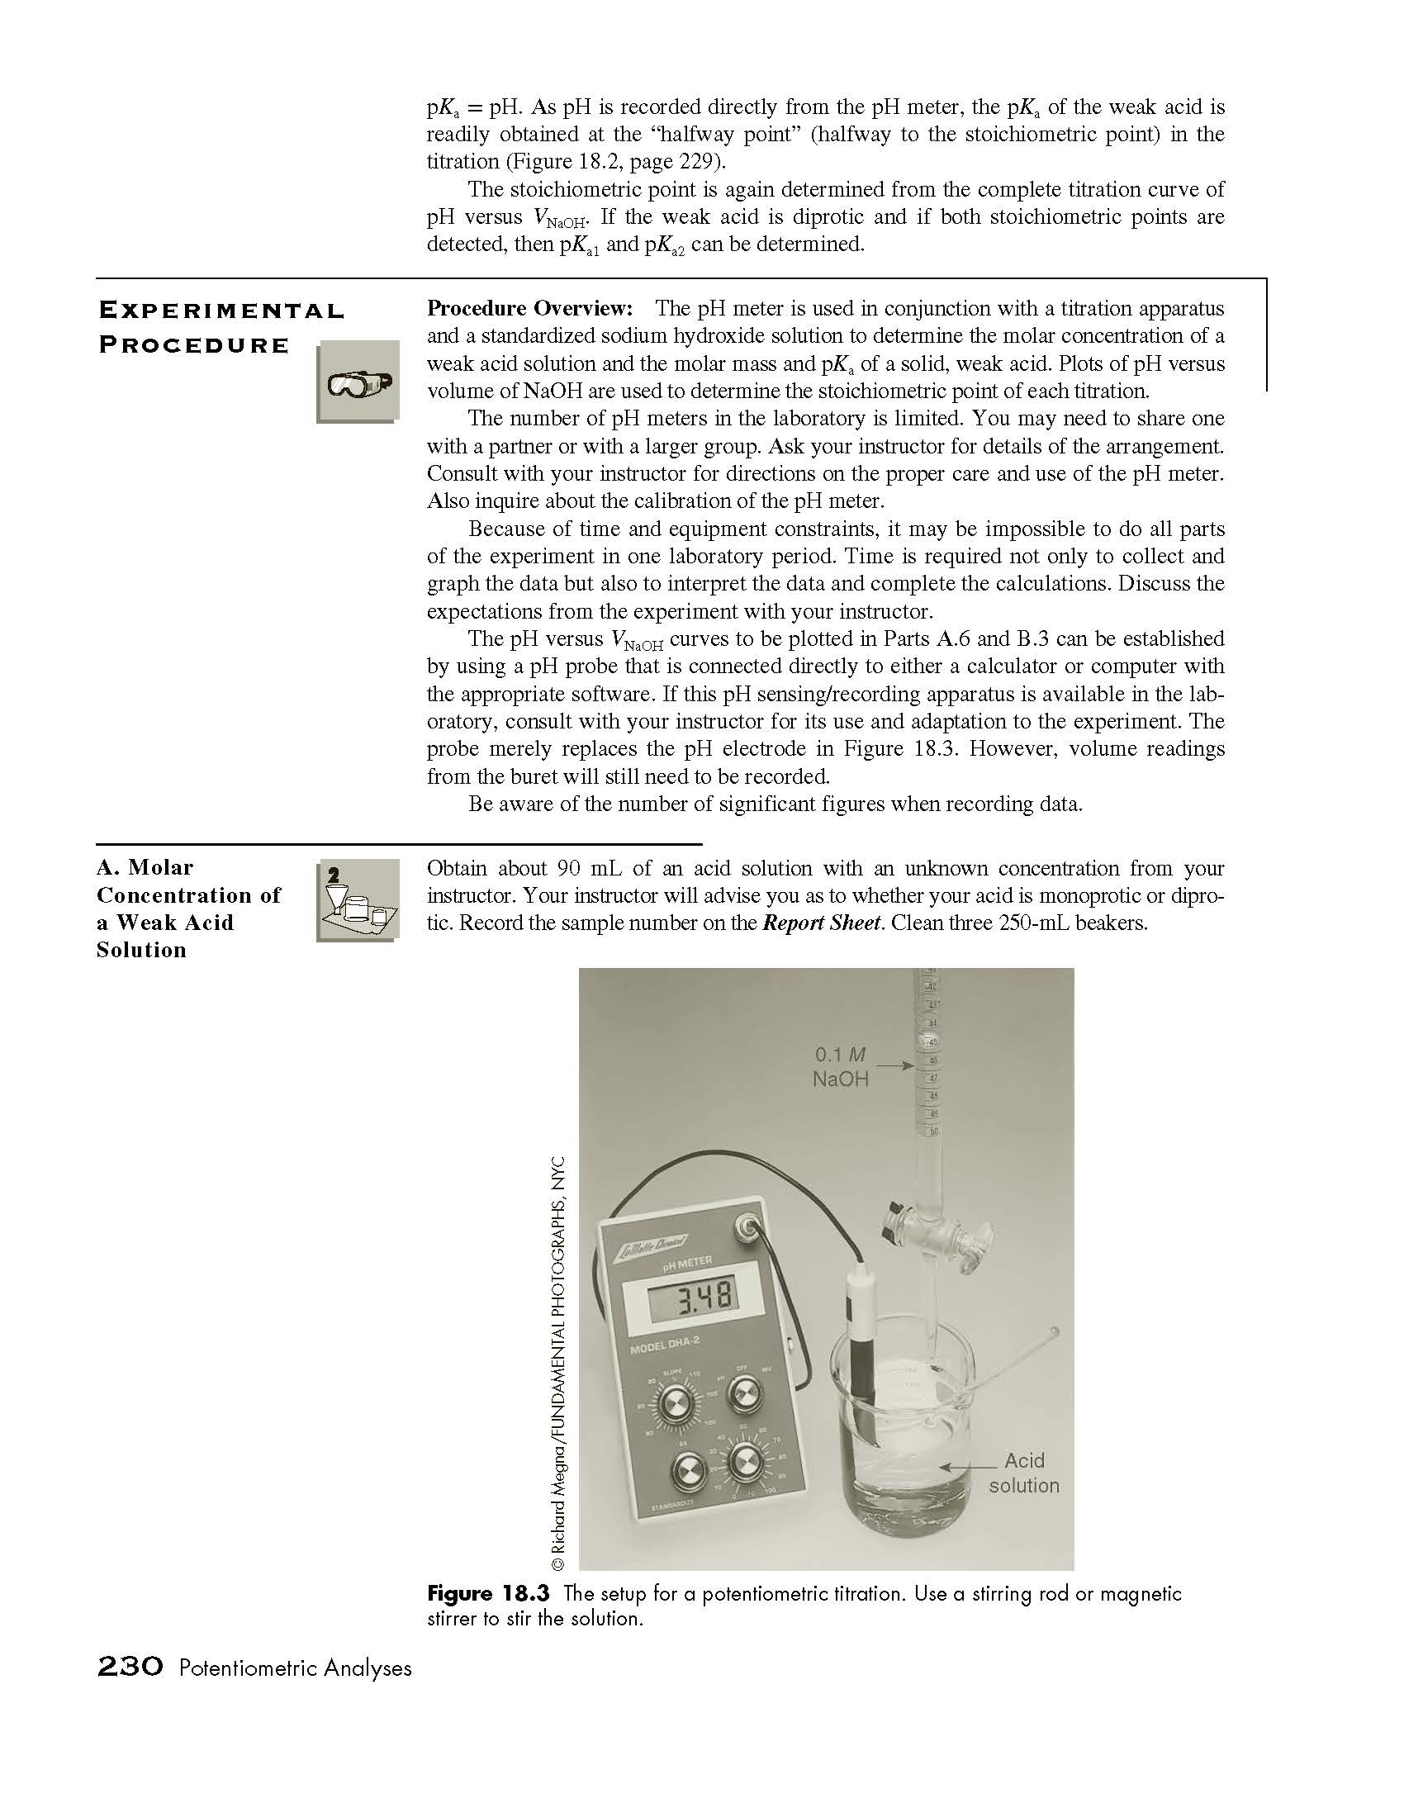

Slide 11
